Slide 1
^{John 4}
⁴Now he had to go through Samaria. ⁵So he came to a town in Samaria called Sychar, near the plot of ground Jacob had given to his son Joseph. ⁶Jacob’s well was there, and Jesus, tired as he was from the journey, sat down by the well. It was about the sixth hour.
⁷When a Samaritan woman came to draw water, Jesus said to her, “Will you give me a drink?” ⁸(His disciples had gone into the town to buy food.)

Slide 2
⁹The Samaritan woman said to him, “You are a Jew and I am a Samaritan woman. How can you ask me for a drink?” (For Jews do not associate with Samaritans.ª)
¹⁰Jesus answered her, “If you knew the gift of God and who it is that asks you for a drink, you would have asked him and he would have given you living water.”

Slide 3
¹¹“Sir,” the woman said, “you have nothing to draw with and the well is deep. Where can you get this living water? ¹²Are you greater than our father Jacob, who gave us the well and drank from it himself, as did also his sons and his flocks and herds?”
¹³Jesus answered, “Everyone who drinks this water will be thirsty again, ¹⁴but whoever drinks the water I give him will never thirst. Indeed, the water I give him will become in him a spring of water welling up to eternal life.”

Slide 7
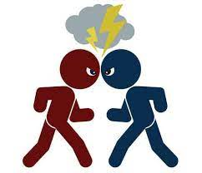
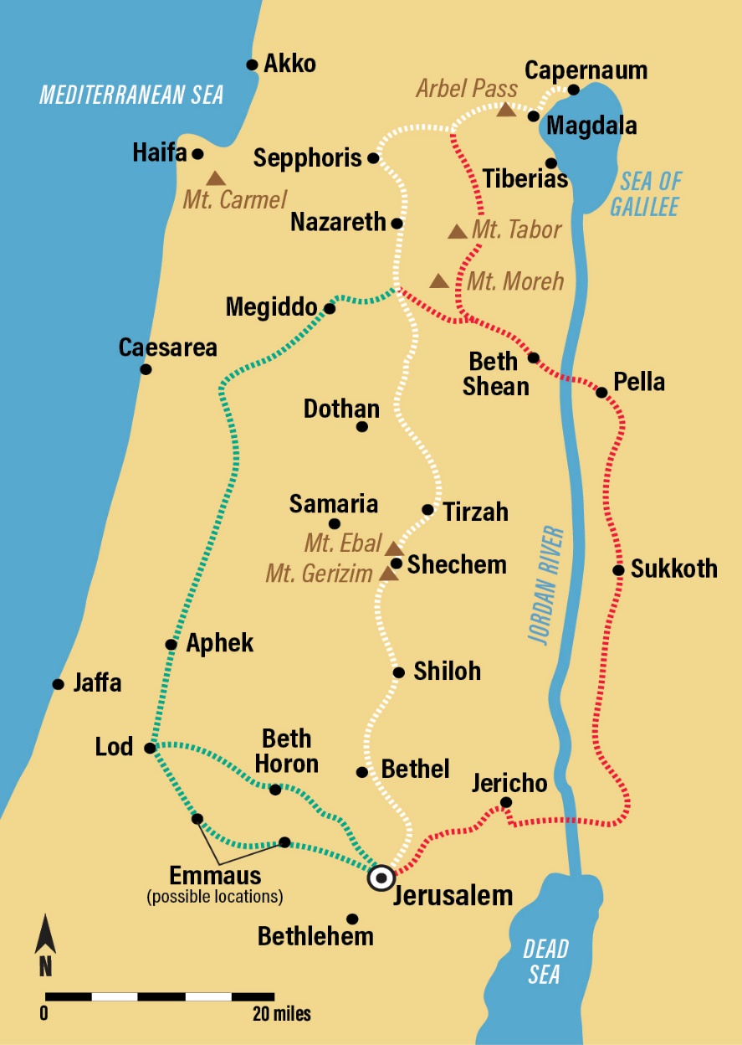
John 4
Background
Jews and Samaritans

Slide 8
John 4
Background
Jews and Samaritans
Verse 4 Jesus had to go through
Samaria
Verse 6 Jesus is tired takes a break
at midday
Verse 7 Jesus engages by asking a
the woman a question

Slide 9
John 4
Face to face with self
V16 Go call your husband
We are both
moral and spiritual and
physical and material beings

Slide 10
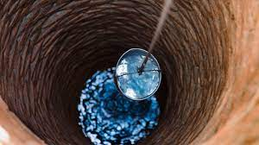
John 4
Face to face with God
4:19-26
New spiritual era - v23 -24
God is Spirit and his worshippers
must worship in spirit and truth

Slide 11
John 4
Face to face with Jesus
V 26 Jesus says “I am the Messiah”
V29 “Come see a man who told me everything I ever did. Could this be the Christ?”
V27-38 Jesus talks with the disciples

Slide 12
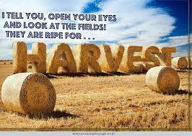
John 4
Face to face with Jesus
V 42 “Now we have heard for ourselves and we know that this man really is the Saviour of the world.”

Slide 13
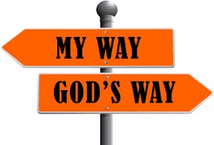
Points to think over
Be aware of God directing your path each day.
Where do you need to go?
Pray and ask God to lead you wherever you go each day
Live with a sense of a heavenly destiny

